Slide 1


Monitoring with Prometheus and Grafana
Assuring business value
Lucas Jellema, CTO of AMIS
Fall 2018
Notes:
Fast data arrives in real time and potentially high volume. Rapid processing, filtering and aggregation is required to ensure timely reaction and actual information in user interfaces. Doing so is a challenge, make this happen in a scalable and reliable fashion is even more interesting. This session introduces Apache Kafka as the scalable event bus that takes care of the events as they flow in and Kafka Streams and KSQL for the streaming analytics. Both Java and Node applications are demonstrated that interact with Kafka and leverage Server Sent Events and WebSocket channels to update the Web UI in real time. User activity performed by the audience in the Web UI is processed by the Kafka powered back end and results in live updates on all clients.
Fast data arrives in real time and potentially high volume. Rapid processing, filtering and aggregation is required to ensure timely reaction and actual information in user interfaces. Doing so is a challenge, make this happen in a scalable and reliable fashion is even more interesting. This session introduces Apache Kafka as the scalable event bus that takes care of the events as they flow in and Kafka Streams for the streaming analytics. Both Java and Node applications are demonstrated that interact with Kafka and leverage Server Sent Events and WebSocket channels to update the Web UI in real time. User activity performed by the audience in the Web UI is processed by the Kafka powered back end and results in live updates on all clients. Introducing the challenge: fast data, scalable and decoupled event handling, streaming analytics Introduction of Kafka demo of Producing to and consuming from Kafka in Java and Nodejs clients Intro Kafka Stream API for streaming analytics Demo streaming analytics from java client Intro of web ui: HTML 5, WebSocket channel and SSE listener Demo of Push from server to Web UI - in general End to end flow: - IFTTT picks up Tweets and pushed them to an API that hands them to Kafka Topic. - The Java application Consumes these events, performs Streaming Analytics (grouped by hashtag and author and time window) and counts them; the aggregation results are produced to Kafka - The NodeJS application consumes these aggregation results and pushes them to Web UI - The WebUI displays the selected Tweets along with the aggregation results - in the Web UI, users can LIKE and RATE the tweets; each like or rating is sent to the server and produced to Kafka; these events are processed too through Stream Analytics and result in updated Like counts and Average Rating results; these are then pushed to all clients; this means that the audience can Tweet, see the tweet appear in the web ui on their own device, rate & like and see the ratings and like count update in real time

Slide 2

Lucas Jellema Architect / Developer 1994 started in IT at Oracle 2002 joined AMIS Currently CTO & Solution Architect

Slide 3
Overview
Why monitoring?
How monitoring?
Metrics
gathering | processing | analyzing | presenting | alerting
Prometheus
History
Metrics
Exporters
Instrumentation of Applications
Grafana
Dinner
Handson Workshop

Slide 4
Monitoring
Observe [non-functional] behavior of business functions/applications in pnear] real-time
Availability and health
Performance
Access – as it should be for whom it should be
Teams up with:
Profiling & Debugging – maximum context for activity spikes
Tracing – track paths through application [and platform & infra] stack
Logging – per application or platform component output for off-line processing
although log agents such as Elastic Stack Beats and Elasticsearch

Slide 5
What is required for monitoring?
Gather metrics
And prepare | wrangle metrics (tag, filter, enrich, aggregate, …)
To raise alert
To human (via ticket/SMS/…)
To automated handler/agent
To support issue resolution (data for root cause analysis)
To analyze trends + effects/impact of change

Slide 6
Type of metrics
Primary metrics
Tied to SLA indicators
Relevant – representative of Key Performance Indicators
End user experience
Business activity throughput
Cost efficiency
Secondary metrics
Predictors for primary metrics
Technical metrics
Hygiene factors – not directly tied to specific business indicators
Temperature, Remaining Free Storage, Network Load,

Slide 7
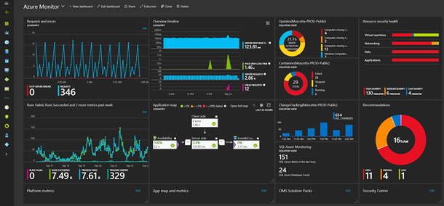
Dashboard
Provide starting point to respond to an alert – start investigation (drill down, query)
Demonstration purposes
Always looks nice – a dashboard

Slide 8
Metrics are collected across the stack
Business Applications
SaaS, Standard Applications
Custom | Tailor made applications
Platform
Web Server, Application Server
Database
LDAP
JVM/Node/.NET/… runtime
Infra
Container, Container Platform (e.g. Kubernetes)
Operating System
Cache
Proxy, Load Balancer
Network
Storage, File System
metrics

Slide 9
Monitoring
UI to browse metrics data
Alert Handler (real time alert condition evaluator)
notifications
Bus App
API to query metrics data
Platform Component
metrics
Metrics Store (time series)
Infra Component

Slide 10
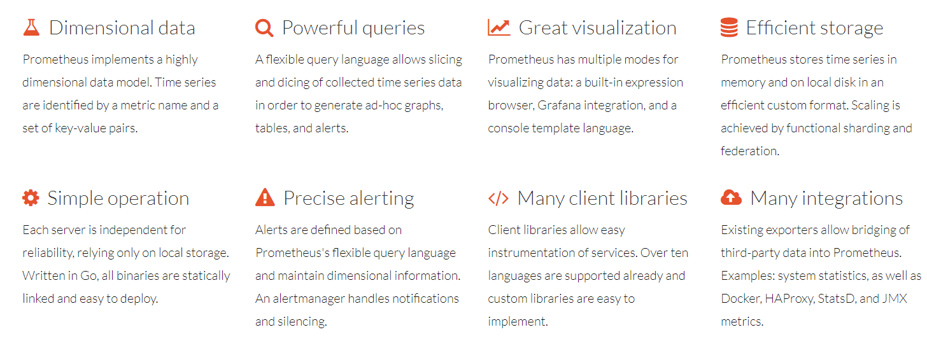
History and Status of Prometheus
Written in Go Lang – all open source, available on GitHub
Part of CNCF
https://prometheus.io/
Since 2012
Defacto standard for gathering metrics (?)
treating time-series data as a data source for generating alerts is now accessible to everyone through those open source tools like Prometheus
Notes:
https://en.wikipedia.org/wiki/Draft:Prometheus_(software)

Slide 11
Prometheus
Gather metrics into database
Scheduled pull |harvest| scrape actions – HTTP/TCP requests
Accessing Exporters and built in (scrape) endpoints
Make metrics availabe to consuming systems and humans
Such as Grafana (for dashboarding)
REST APIs
Prometheus UI – Graphs, Console, PromQL
Analyze metrics according to [alert] rules
Determine if alerts are “firing”
Act on firing alerts
Send notifications
Supports federation – global view over local environments and recovery of local environment

Slide 12
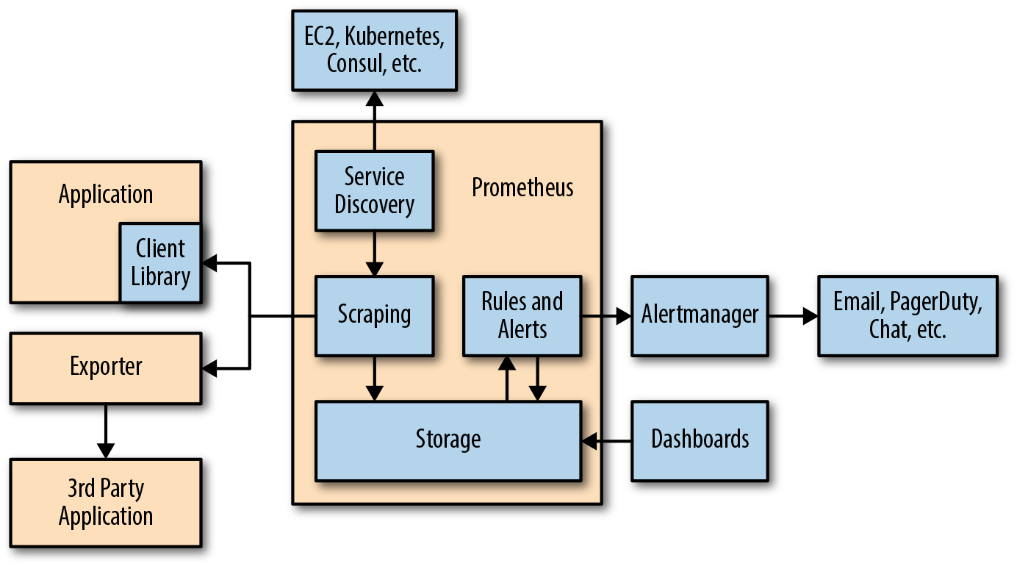
Prometheus Architecture

Slide 13
Prometheus Metrics
All are numeric
Uniquely identified by name and set of labels
All can be labeled (associated with dimensions)
Aggregation is done grouped by dimension
(labels should have limited number of values)
Filtering and Drill down is also done using labels
Examples of labels:
Data Center, Region
Environment (Prod, Acc, Test)
Service, Application, Module
URL Path, request type, status, error code
Not for dynamic aspects such as date, time, user id, user IP
Notes:
https://pierrevincent.github.io/2017/12/prometheus-blog-series-part-1-metrics-and-labels/

Slide 14
Demo – Getting started with Prometheus
prometheus.yml
- job_name: 'prometheus'
# metrics_path defaults to /metrics
# scheme defaults to 'http'.
static_configs:
- targets: ['localhost:9090']
Notes:
Preparation:
Vagrant Up
Vagrant SSH (open a few command windows with vagrant ssh into VM)
Run Prometheus
./prometheus
Show metrics: http://192.168.188.112:9090/metrics
Open Web UI
http://192.168.188.112:9090/targets
Show Prometheus itself as target
Goto Graph
Show Prometheus metrics
Show [1m]
Show rate ([1m])

Slide 15
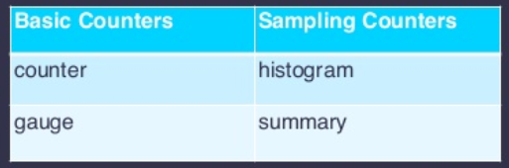
Prometheus – Types of Metrics
Basic counters:
Gauge – current value (%disk free, response time, state of database)
Counter - #occurrences – and the derived rate - #occurrences/time unit - (number of requests, number of bytes transferred);
counters can be reset but not decremented
Sampling Counters:
Summary – reports quantiles as well as total sum and total count (over sliding window)
Histogram – maps observations to buckets and reports number of instances per bucket (over sliding window)

Slide 16
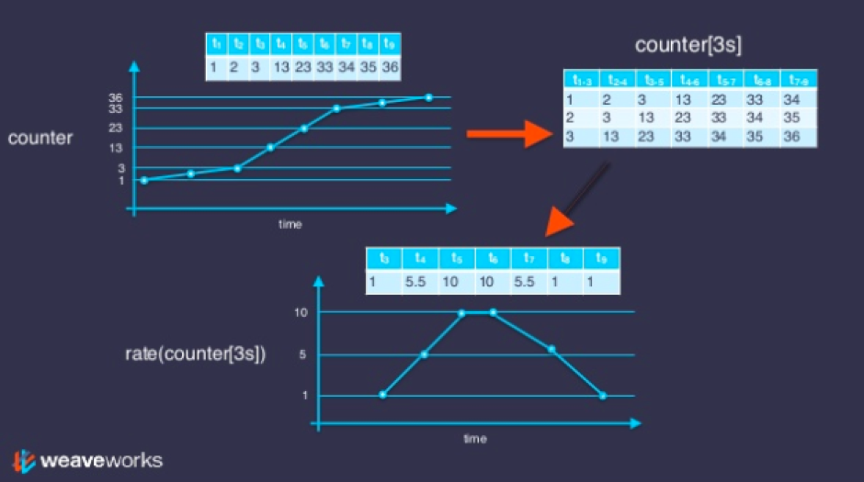
Counter – per time slice and as a rate
Notes:
[5m] will consider all data-points captured for our batch_jobs_completed_total metric for 5 minutes. Applying rate() to a range vectorcalculates the average rate of increase per second during that time-window.

Slide 17
Exposing Metrics for Prometheus to Scrape
Have the application or environment listen for HTTP requests at a specific endpoint (for example: host:port/metrics)
Return Metrics in the proper format to GET requests to this endpoint
Use a Client Library to easily compose the proper metrics response messages
Configure the endpoint on the Prometheus server in the prometheus.yml file
prometheus.yml
- job_name: node-app
scrape_interval: 5s
metrics_path: /metrics
static_configs:
- targets:
- 127.0.0.1:3001

Slide 18
Client Libraries for Exposing Metrics for Prometheus to Scrape from custom applications
Go
Java or Scala
Python
Ruby
Bash
C++
Common Lisp
Elixir
Erlang
Haskell
Lua for Nginx
Lua for Tarantool
.NET / C#
Node.js
PHP
Rust

Slide 19
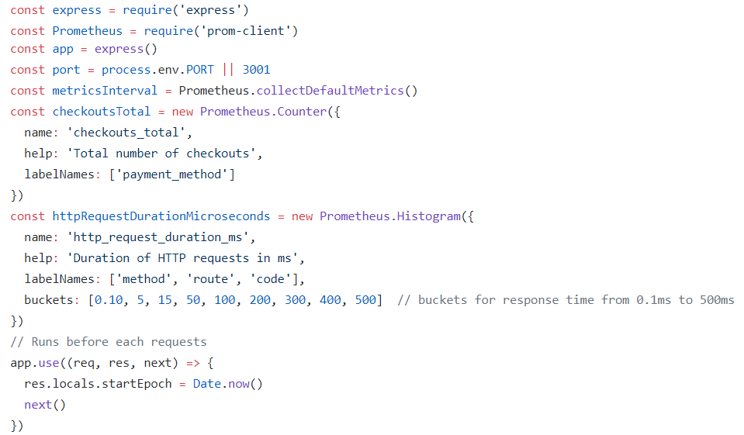
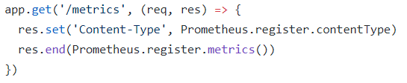
Example of Exposing Metrics from a Node application
Notes:
Add Node app scrape job in prometheus.yml
Run Node application
Access Node app at http://192.168.188.112:3001/checkout

Slide 20
Prometheus Exporters
Specialized adapters to expose metrics for specific technology components
Installed and configured for a specific component
Scraped by Prometheus based on config file prometheus.yml that references the endpoint exposed by the exporter

Slide 21

Prometheus Exporters
Linux & Windows
Databases
Messaging Systems
Storage
HTTP
APIs
Logging
Monitoring Systems
Application Servers & Container Platforms
Blackbox Exporter
A growing number of components has built-in Promethes metrics publication
Notes:
https://prometheus.io/docs/instrumenting/exporters/

Slide 22
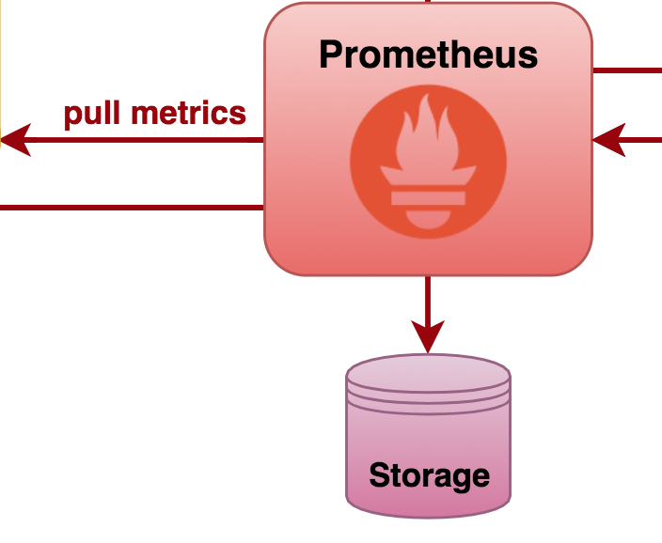

For example: Oracle Database Exporter
Oracle Database
Query v$ views & data dictionary objects
Prometheus Oracle Exporter
Handles HTTP requests at /metrics
Notes:
https://github.com/freenetdigital/prometheus_oracle_exporter

Slide 23
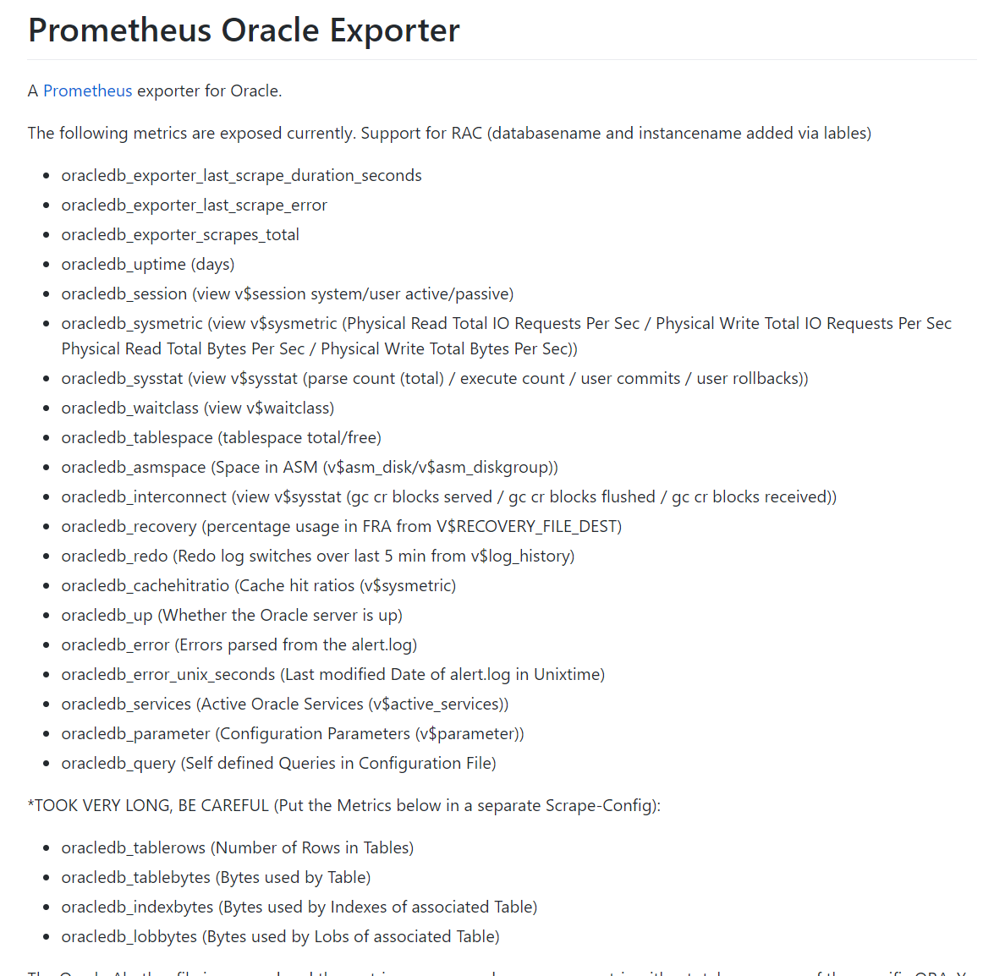
Oracle Database
Prometheus Oracle Exporter

Slide 24

Demo – (Linux) Node Exporter
Run node exporter as background job on Linux node
Node Exporter
Notes:
Run Linux exporter

Slide 25
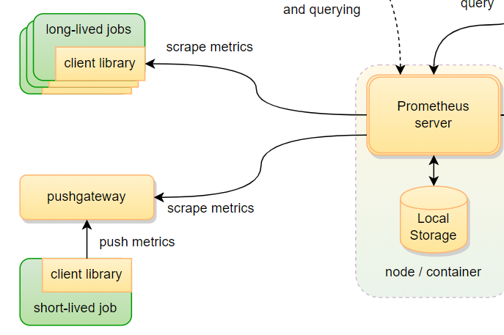
Pushgateway for Short-Lived Jobs
Jobs that may be gone before their metrics are scraped

Slide 26
Prometheus Alerting

Slide 27
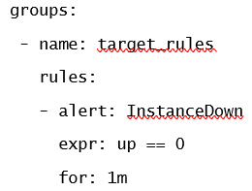
Prometheus Alerting
Rules specify alert conditions
Expressed in Prometheus metrics
Prometheus evaluates these rules –
As time progresses
As metrics get updated
An alert is be triggered
When the expr evaluates to true
For at least as long as is specified in the for condition
A triggering alert
Can be found in the Prometheus Web UI
Is notified to the Alert Manager
The Alert Manager is configured for action
For example: send notification via specific communication channels

Slide 28
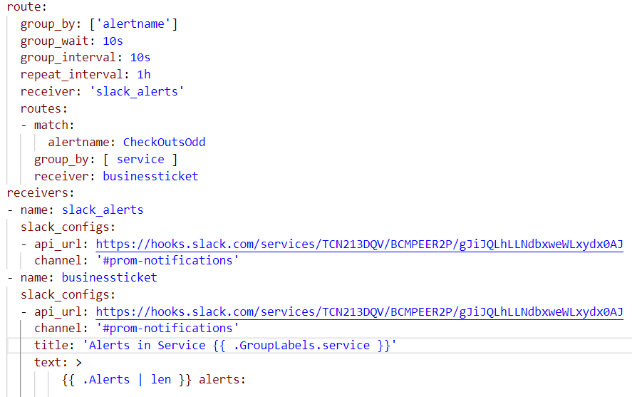
Alertmanager Configuration
The route to apply depends on matching conditions
Each receiver can use a different communication channel and notification layout
Each receiver can use a different communication channel and notification layout

Slide 29
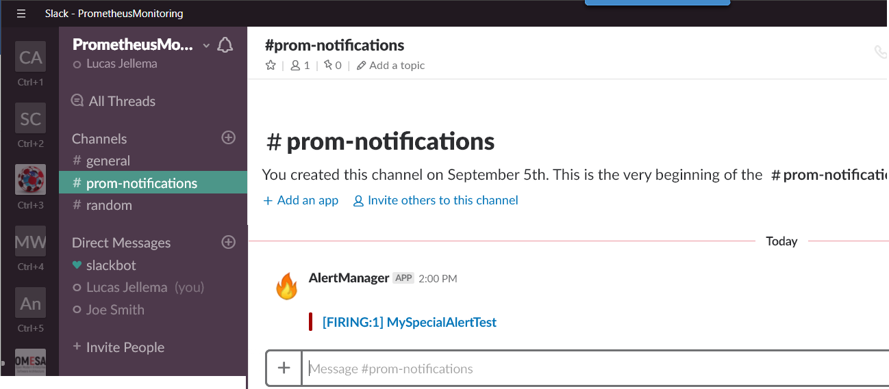
Prometheus Alerting Demo
Node Exporter

Slide 30
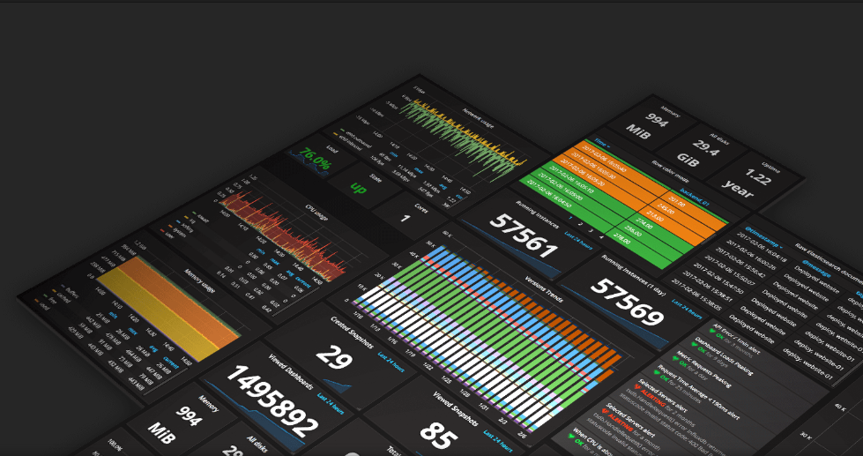
Dashboarding

Slide 31

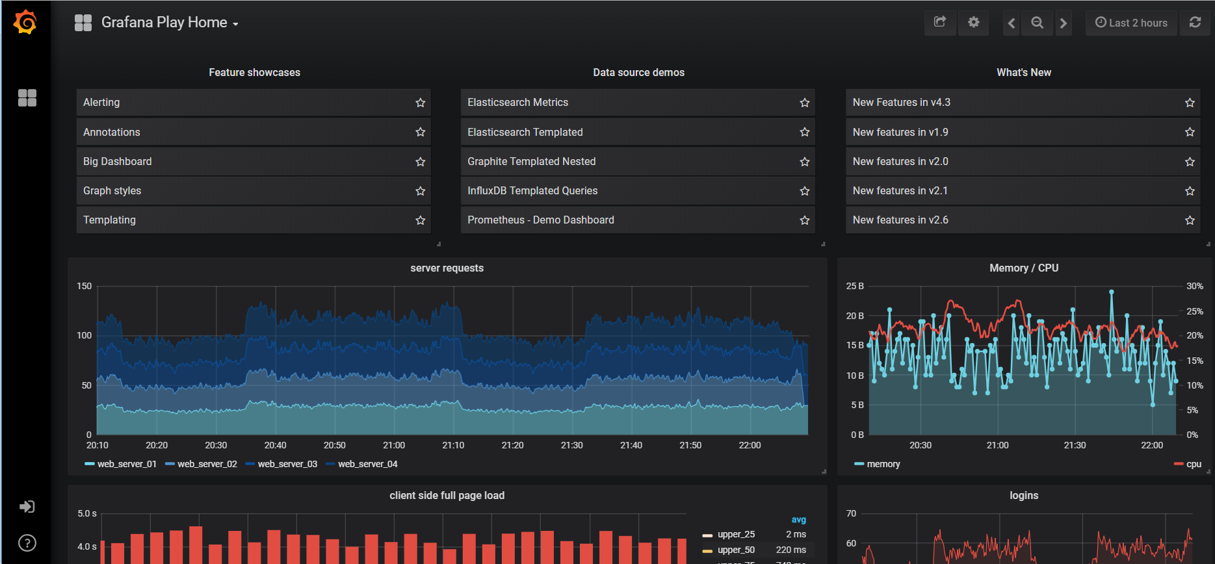
Grafana - dashboarding
Grafana is a generic open source dashboard product
Supporting many types of data sources, of which Prometheus is but one
Grafana queries data sources (such as Prometheus) periodically
Does not store any data
Refreshes visualizations
Evaluates alert conditions and triggers alerts/sends notifications
Extensive library of pre-built dashboards available
Also plugins
Supports user authentication and authorization and multi-tenancy
Online Playground

Slide 32
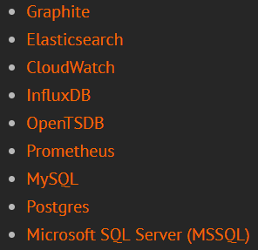
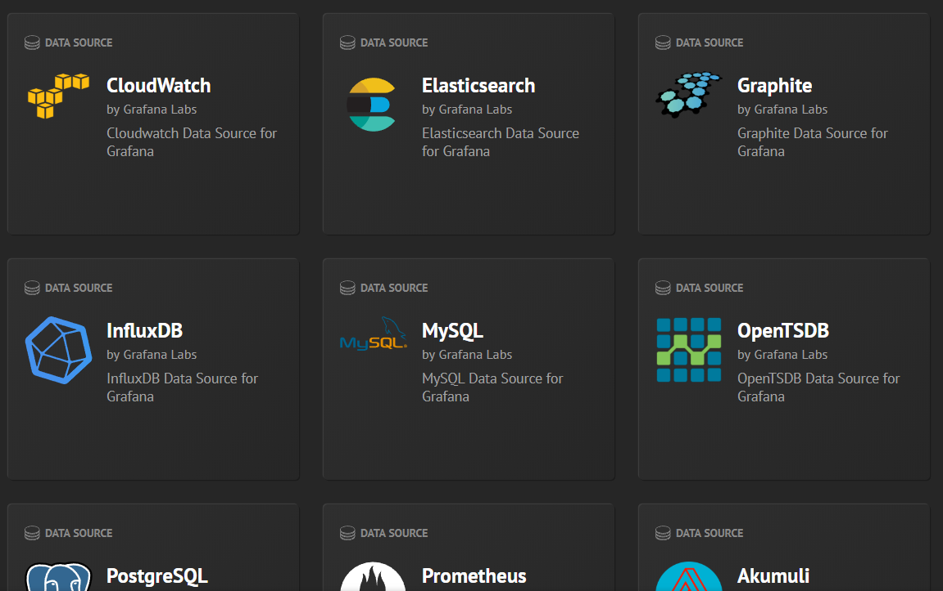
Grafana – Data Sources
Grafana can extract data from many types of data sources
Prometheus is but one
Grafana can use multiple data source to provide data for a panel or chart

Slide 33
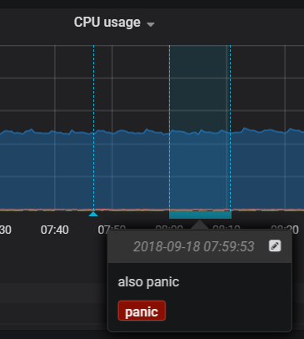
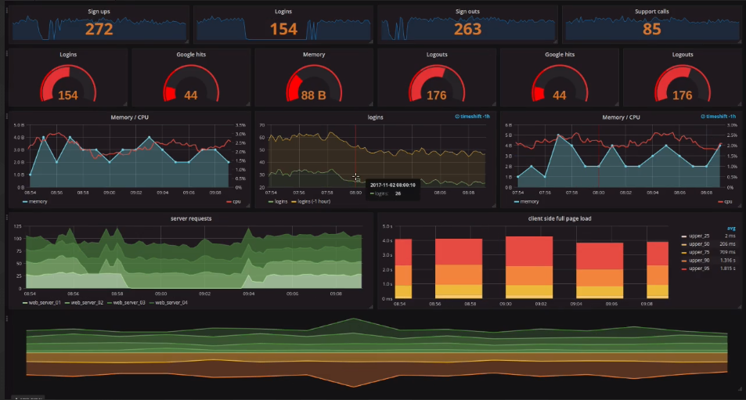
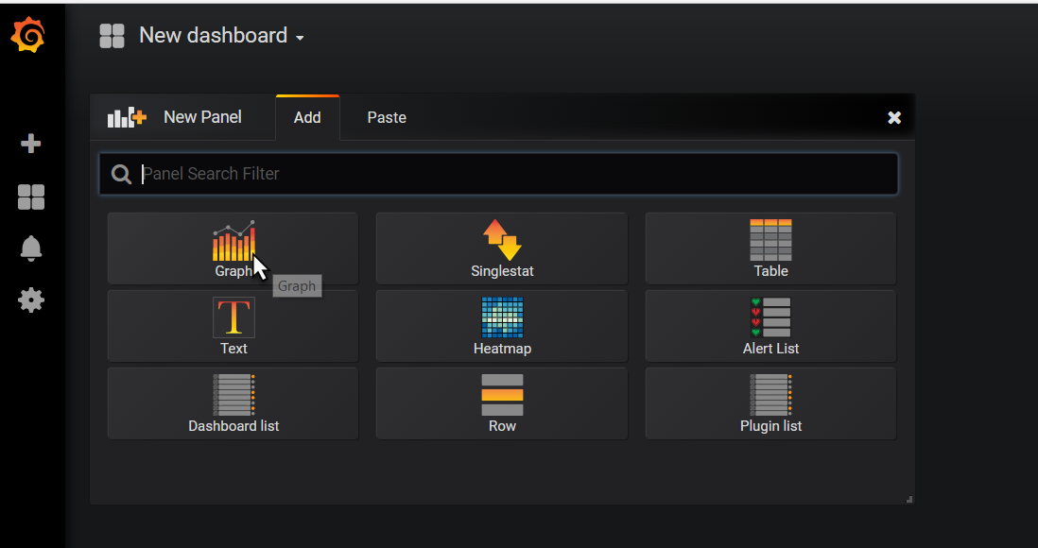
Grafana Visualizations
Annotations

Slide 34
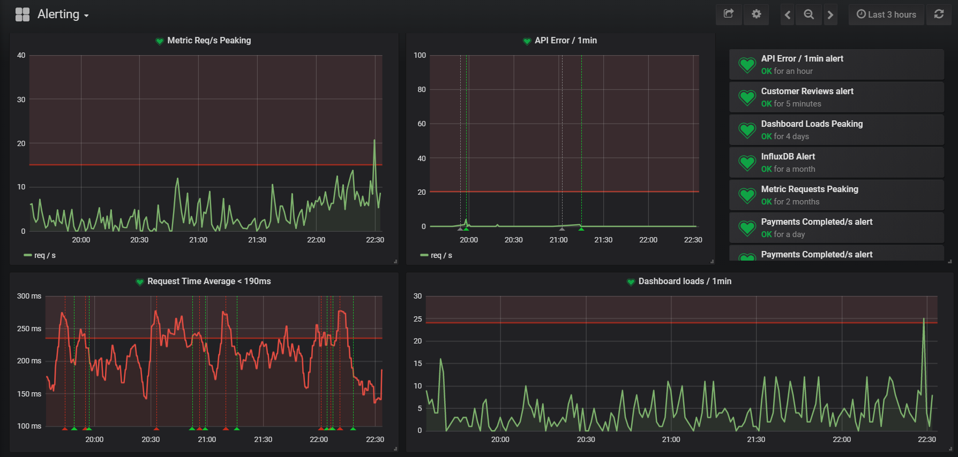
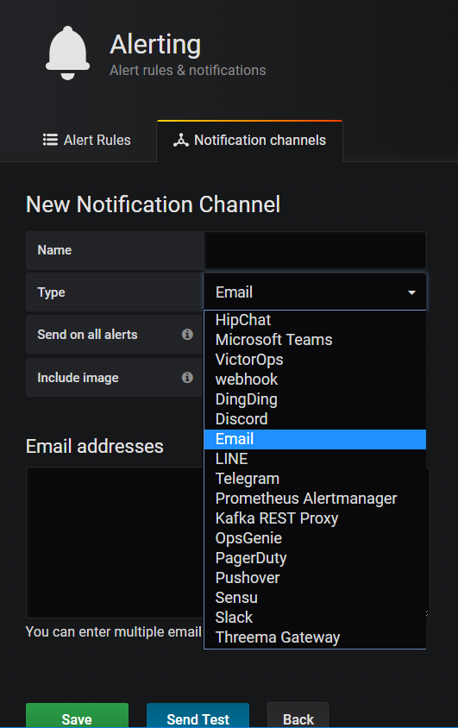
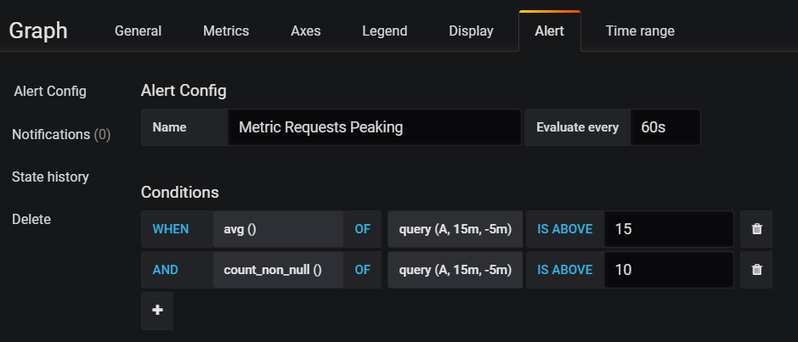
Grafana Alerts and Notifications

Slide 35


Workshop
Materials: http://bit.ly/prometheus-amis
Prometheus
First steps
Exporters for Linux, MySQL, Docker, Blackbox
Custom Application instrumentation (Node application)
Alerting
Alert Manager and Notifications (to Slack)
Grafana
First steps
Preconfigured Prometheus dashboard
Custom Dashboard based on Prometheus metrics
Alerts and notifications
Use prebuilt VM image or build VM from scratch
Need VirtualBox in both cases [and Vagrant for build from scratch]
Notes:
http://bit.ly/prometheus-amis

Slide 36

Getting Started/Useful Resources
KataCoda:
https://www.katacoda.com/courses/prometheus https://www.katacoda.com/courses/prometheus/creating-dashboards-with-grafana
Book: Prometheus Up & Running (O’Reilly, 2018)

Slide 37





धन्यवाद dhanyavaad Thank you Dank je wel
Blog: technology.amis.nl
Email: lucas.jellema@amis.nl
: @lucasjellema
: lucas-jellema
: www.amis.nl, info@amis.nl
https://github.com/lucasjellema
Notes:
Ukranian: Dyakuyu - https://www.google.nl/search?q=thank+you+in+ukrainian&rlz=1C1GGRV_enNL762NL762&oq=thank+y&aqs=chrome.1.69i59l2j69i61j0j69i57j0.1774j0j9&sourceid=chrome&ie=UTF-8
Russian: Spasibo

